Slide 1

CS522 – Big Data Prof: Prem Nair PhD
Project By Jamsrandorj Batbayar /986168/

Slide 2
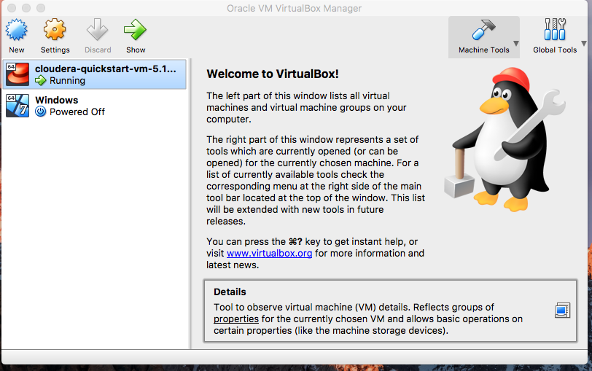
Part1 A. GetVMWareorVirtualBox Visited to the official website and downloaded VirtualBox application and installed it.

Slide 3
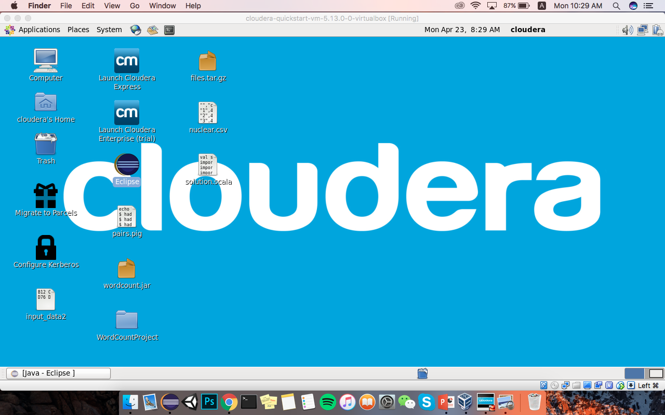
B. GetCloudera Visited to the official website and downloaded the operating system. Created new instance machine on VirtualBox and imported Cloudera into it. Started and tested Cloudera.

Slide 4
C. GetWordCounttestrun On installed cloudera, opened eclipse and imported default wordcount.java from Hadoop official website. Exported test project as a jar file and did some commands on command line of cloudera. Created test input file and printed output.
URL: org.myorg.WordCount
CMD1: hadoop jar /home/cloudera/wordcount.jar org.myorg.WordCount /user/cloudera/wordcount/input /user/cloudera/wordcount/output41 CMD2: hadoop fs –cat /user/cloudera/wordcount/output41/* CMD3: hadoop fs –cat /user/cloudera/wordcount/input/*

Slide 5
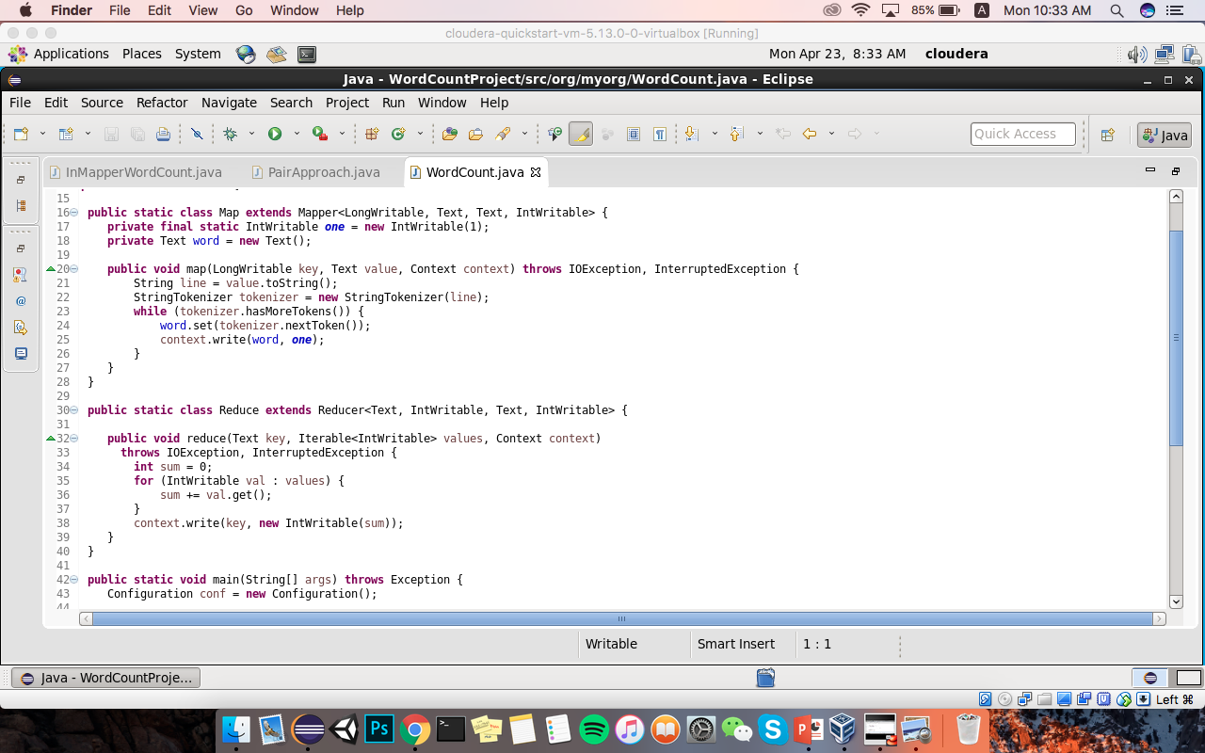

Slide 6
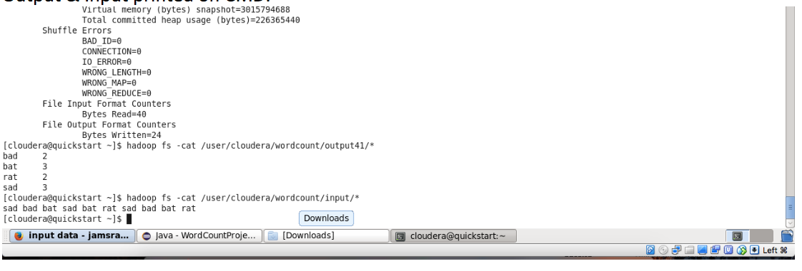
WordCount - Input & Output

Slide 7
D. ModifyWordCounttoInMapperWordCountandtestrun Overridden setup and cleanup methods in order to implement InMapper and also used HashMap to store the data. In the setup function initialized the Hashmap and in the Map function added elements into it. Finally in the cleanup function is writing the context./Used same input data as WordCount and result must be same too./
URL: org.myorg.InMapperWordCount
CMD1: hadoop jar /home/cloudera/wordcount.jar org.myorg.InMapperWordCount /user/cloudera/wordcount/input /user/cloudera/wordcount/output42 CMD2: hadoop fs –cat /user/cloudera/wordcount/output42/* CMD3: hadoop fs –cat /user/cloudera/wordcount/input/*

Slide 8
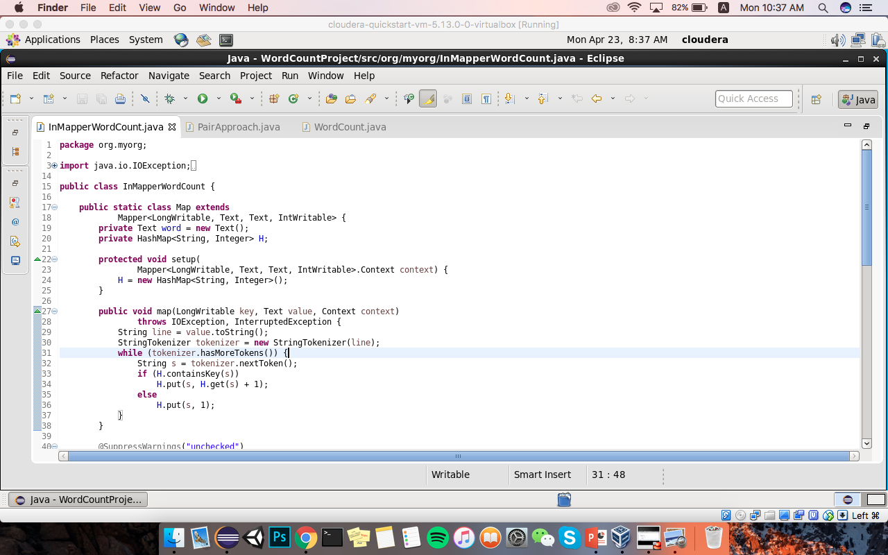
InMapperWordCount - Map

Slide 9
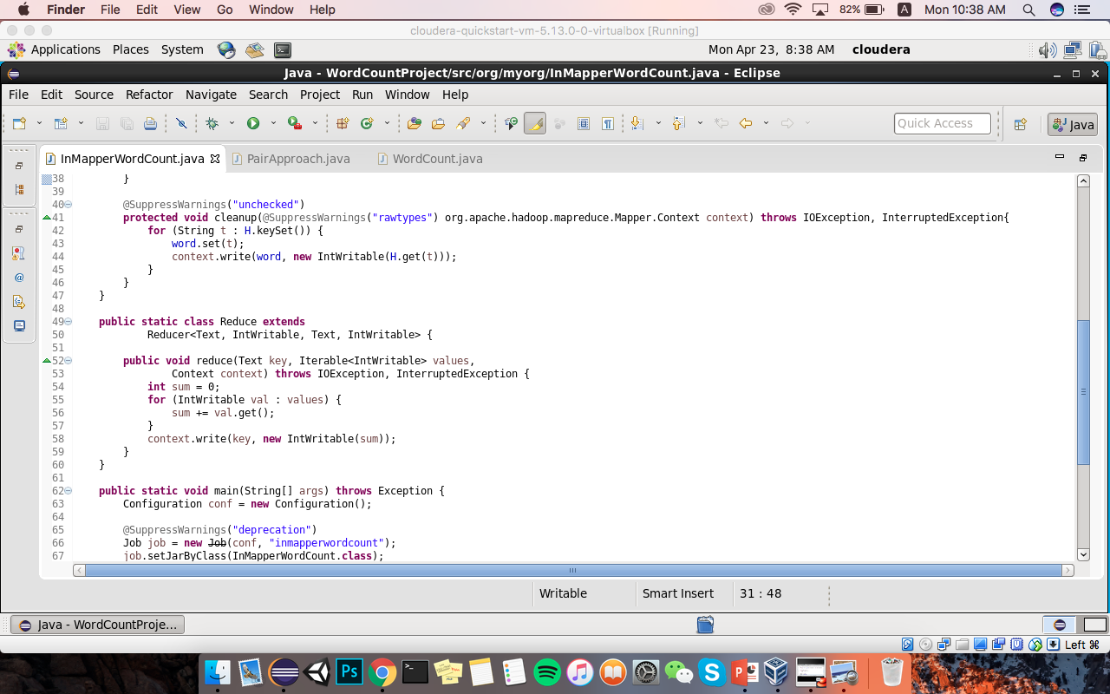
InMapperWordCount - Reduce

Slide 10
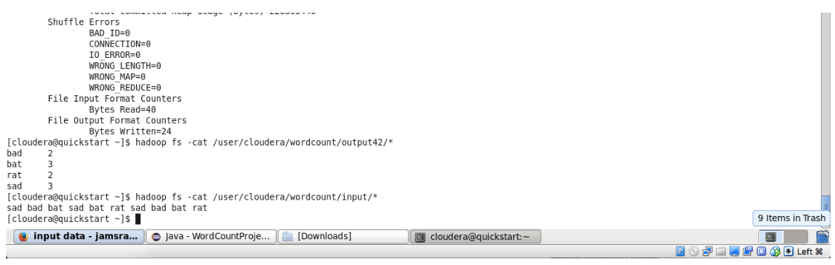
InMapperWordCount - Input & Output

Slide 11
E.ImplementAverageComputationAlgorithm/tocomputetheaverageofthe“last quantity in a Apache log file for each ip address”/
Modified Wordcount class to average algorithm. Modified Map function for the apache log access file, mainly changed word count algorithm to read whole line and added some regex in order to avoid wrong data. Also added some change on reduce. Created and Copied access log file into /user/cloudera/wordcount/input1/ folder and call test data from this director.
URL: org.myorg.AvgCompute
CMD1: hadoop jar /home/cloudera/wordcount.jar org.myorg.AvgCompute /user/cloudera/wordcount/input1 /user/cloudera/wordcount/output43 CMD2: hadoop fs –cat /user/cloudera/wordcount/output43/* CMD3: hadoop fs –cat /user/cloudera/wordcount/input1/*

Slide 12
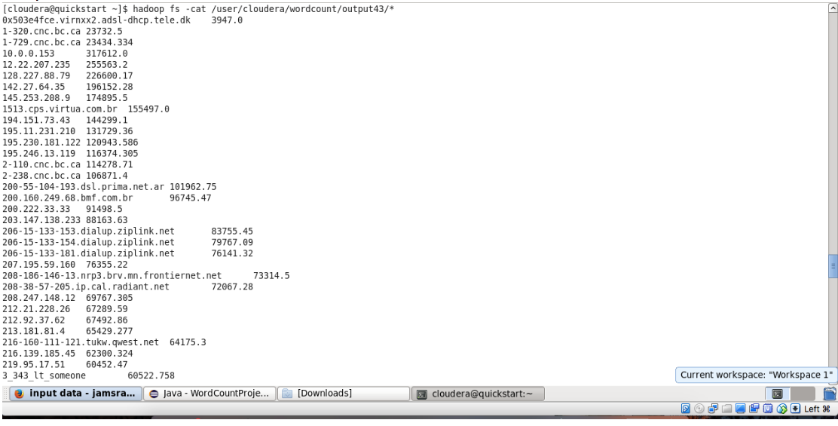
AVGCompute - Output

Slide 13
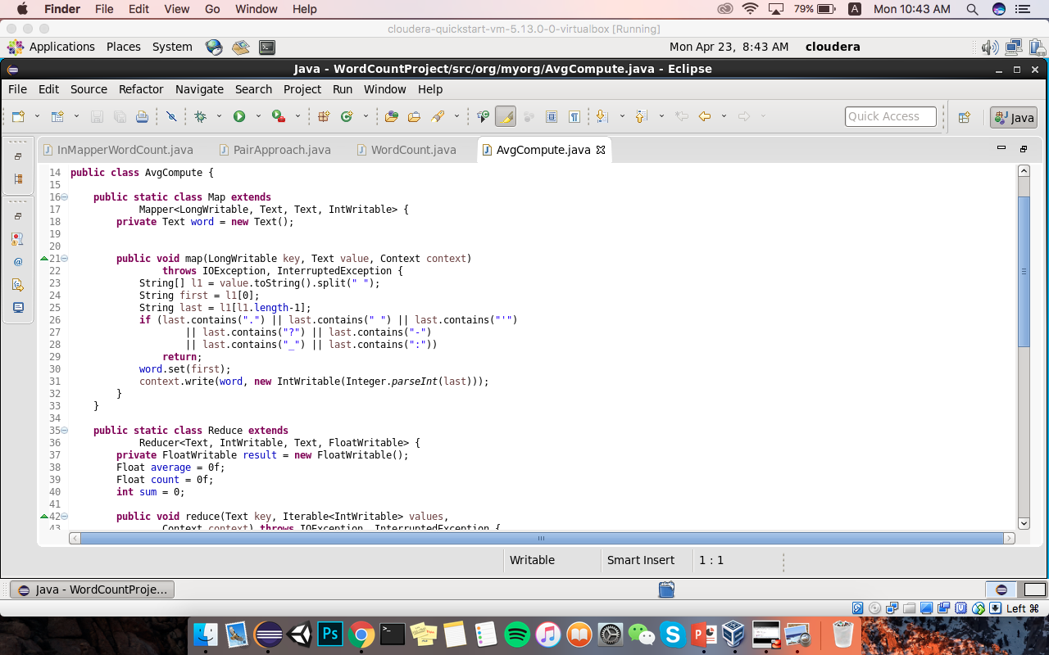
AVGCompute - Map

Slide 14
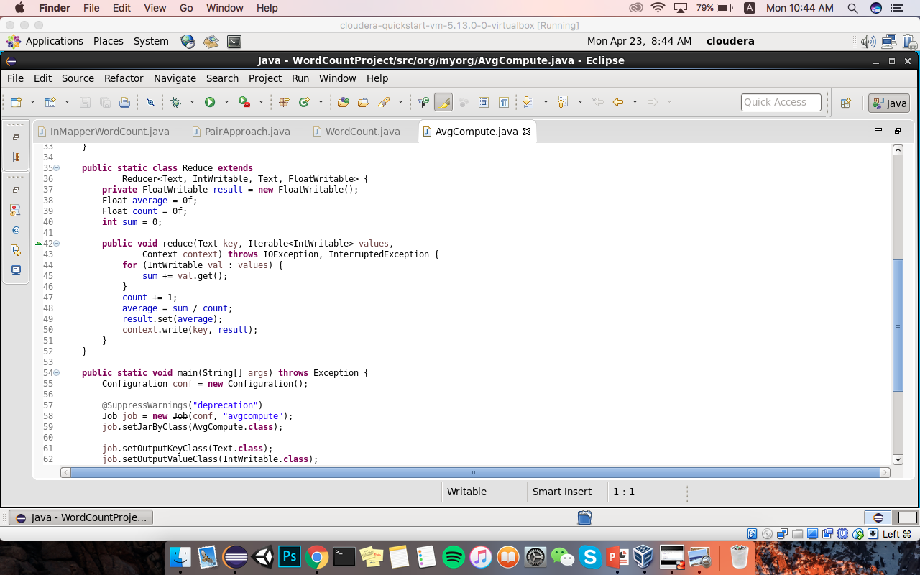
AVGCompute - Reduce

Slide 15
F.ImplementInMapperCombiningalgorithmonAveragealgorithm
Overridden setup and cleanup methods in order to implement InMapper and also used HashMap to store the data. In the setup function initialized the Hashmap and in the Map function added elements into it. Finally in the cleanup function is writing the context. /Used same input data as AvgCompute and result must be same too./
URL: org.myorg.InMapperAvgCompute
CMD1: hadoop jar /home/cloudera/wordcount.jar org.myorg.InMapperAvgCompute /user/cloudera/wordcount/input1 /user/cloudera/wordcount/output44 CMD2: hadoop fs –cat /user/cloudera/wordcount/output44/* CMD3: hadoop fs –cat /user/cloudera/wordcount/input1/*

Slide 16
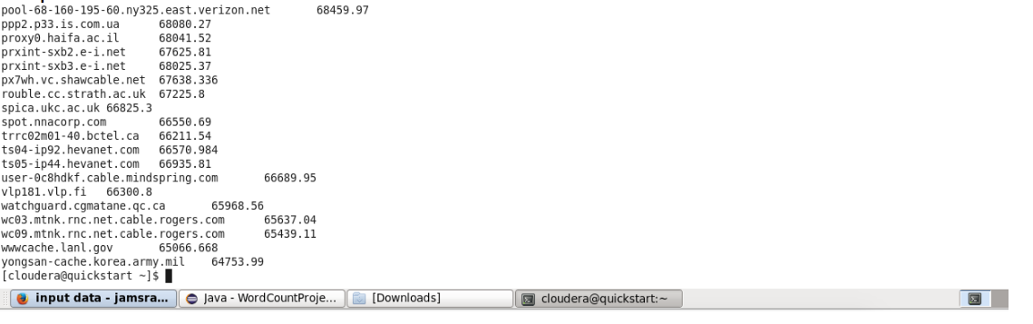
InMapperAVGCompute - Output

Slide 17
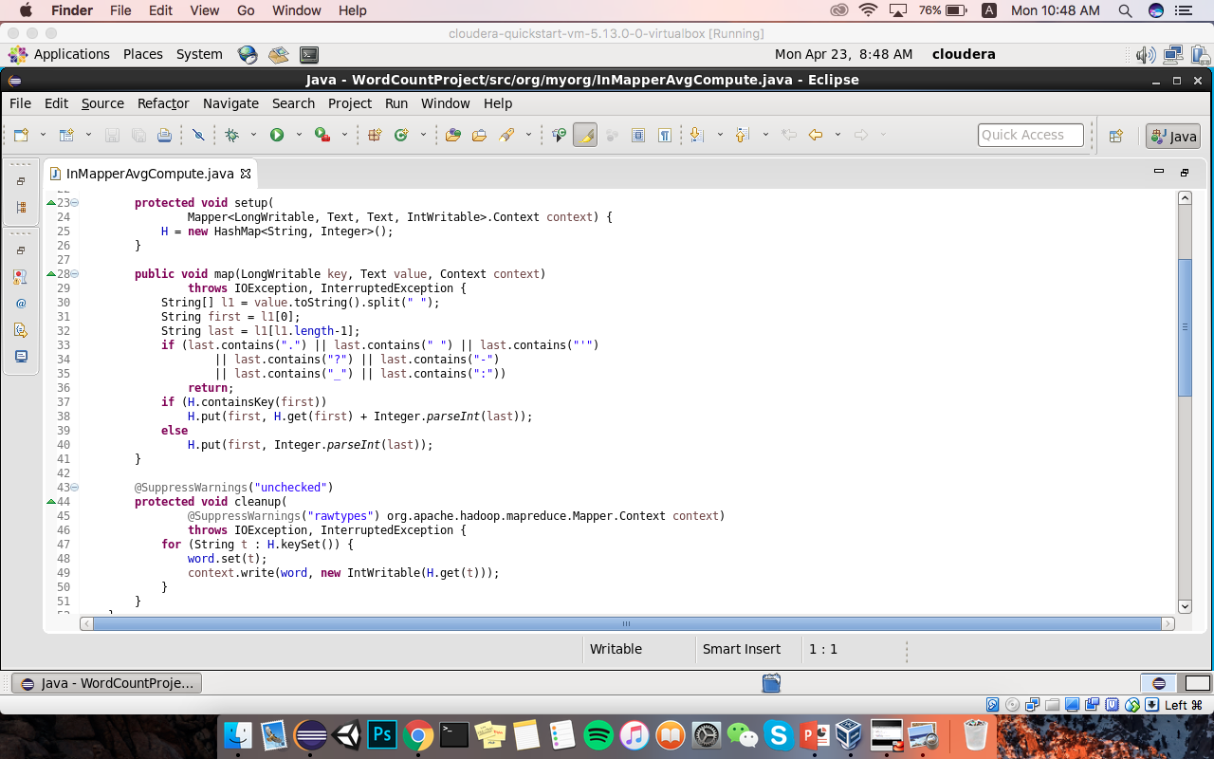
InMapperAVGCompute - Map

Slide 18
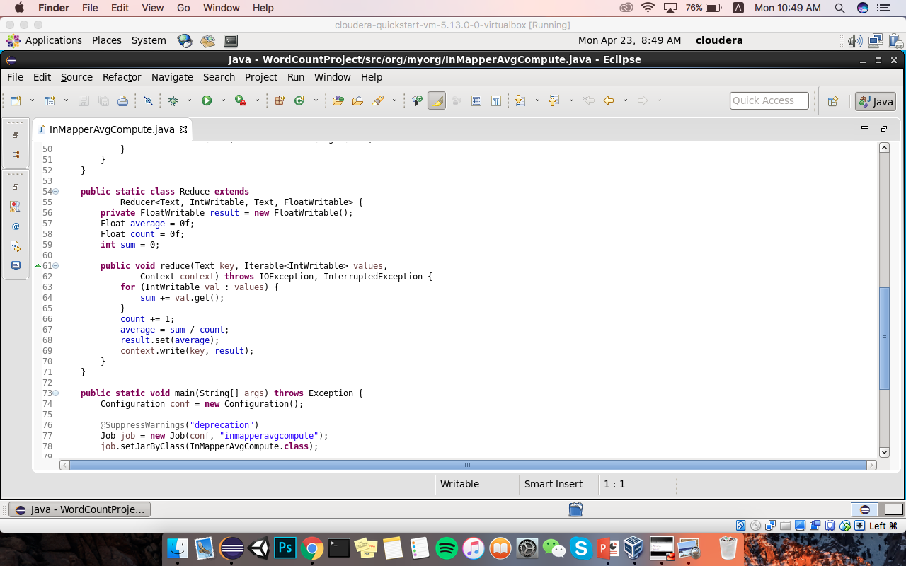
InMapperAVGCompute - Reduce

Slide 19
Part2: Implement Pairs algorithm to compute relative frequencies
Implemented Pair approach. Created custom Pair class in order to save the custom pairs. Stored input data in /user/cloudera/wordcount/input2
URL: org.myorg.PairApproach
CMD1: hadoop jar /home/cloudera/wordcount.jar org.myorg.PairApproach /user/cloudera/wordcount/input2 /user/cloudera/wordcount/output45 CMD2: hadoop fs –cat /user/cloudera/wordcount/output45/* CMD3: hadoop fs –cat /user/cloudera/wordcount/input2/*

Slide 20
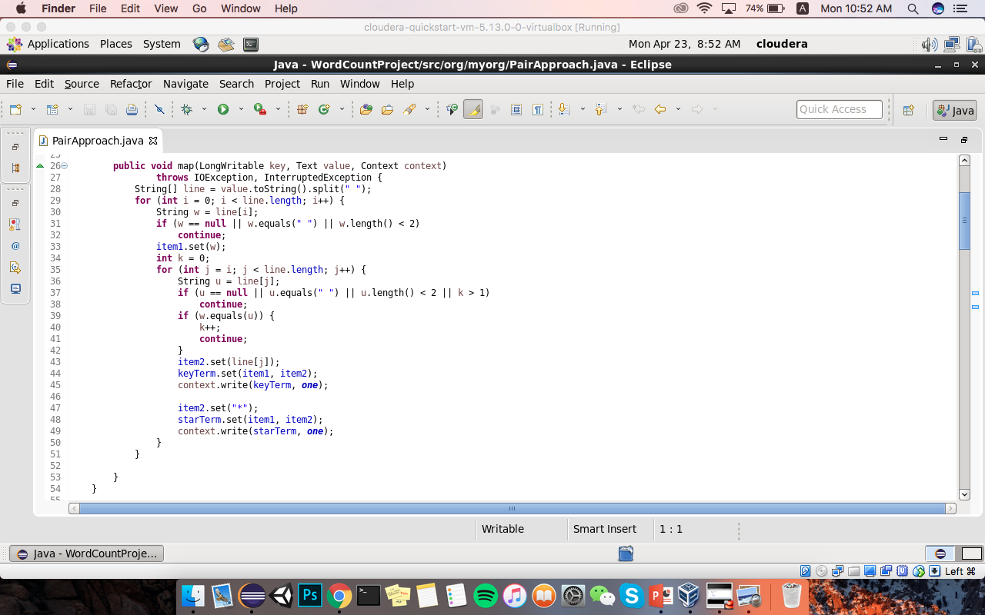
PairApproach - Map

Slide 21
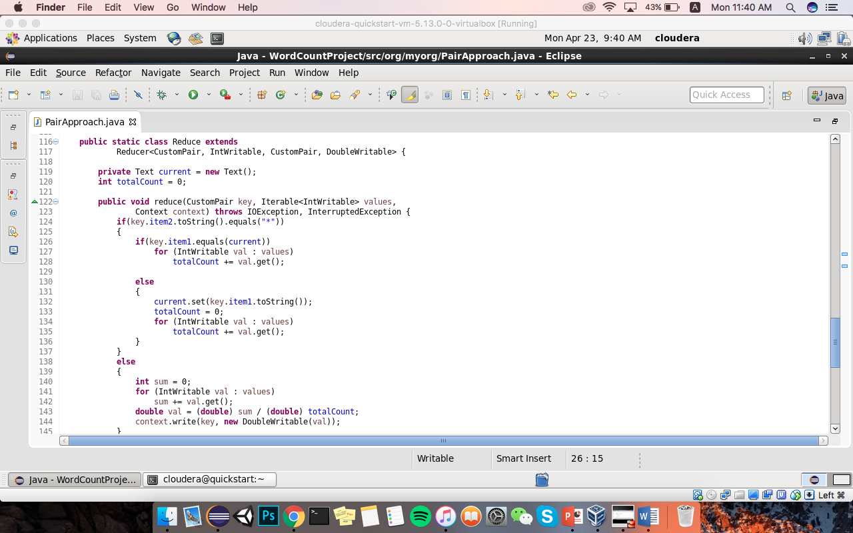
PairApproach - Reduce

Slide 22
PairApproach - Pseudo
Class Mapper
Method Map(docid a, doc d)
For all term w in doc d do
For all term u in Neighbors(w) do
Emit(pair(w,u), count 1)
Emit(pair(w,*), count 1)
Class Reducer
Method Reduce(pair p, counts[c1; c2..])
Sum = 0
For all count c in counts[c1; c2..]
Sum += c
If(p.item2 == *)
total = sum
else
avg = sum/total
Emit(pair p, avg)

Slide 23
Part3: Implement Stripes algorithm to compute relative frequencies
Implemented Stripes approach. Used MapWritable class in order to save the custom stripes, this class is in Hadoop library. Stored input data in /user/cloudera/wordcount/input2 , same as PairApproach.
URL: org.myorg.StripesApproach
CMD1: hadoop jar /home/cloudera/wordcount.jar org.myorg.StripesApproach /user/cloudera/wordcount/input2 /user/cloudera/wordcount/output46 CMD2: hadoop fs –cat /user/cloudera/wordcount/output46/* CMD3: hadoop fs –cat /user/cloudera/wordcount/input2/*

Slide 24
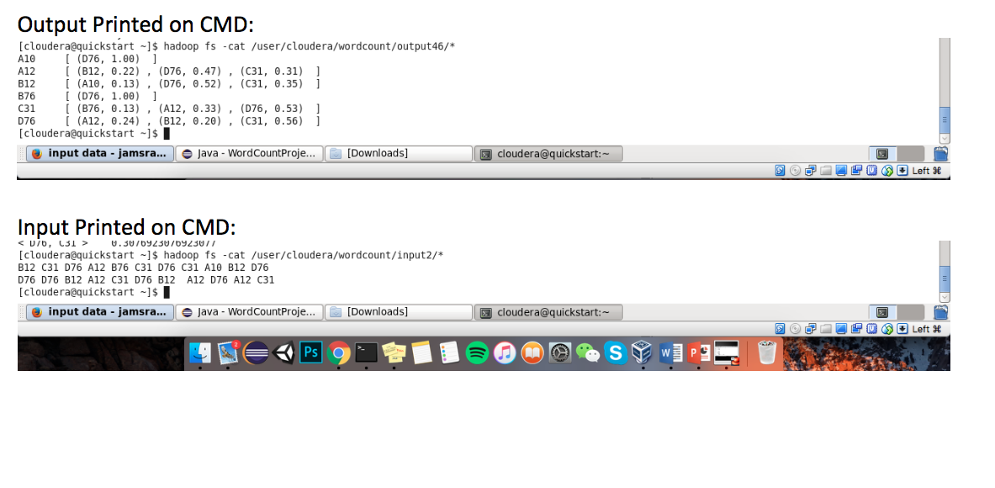
StripeApproach-Output & Input

Slide 25
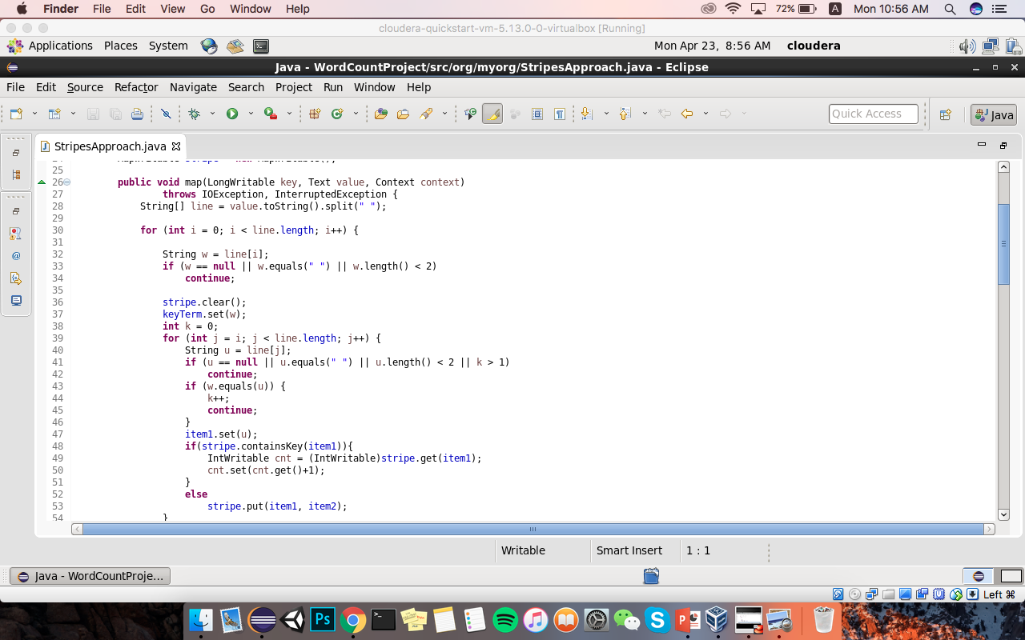
StripeApproach-Map

Slide 26
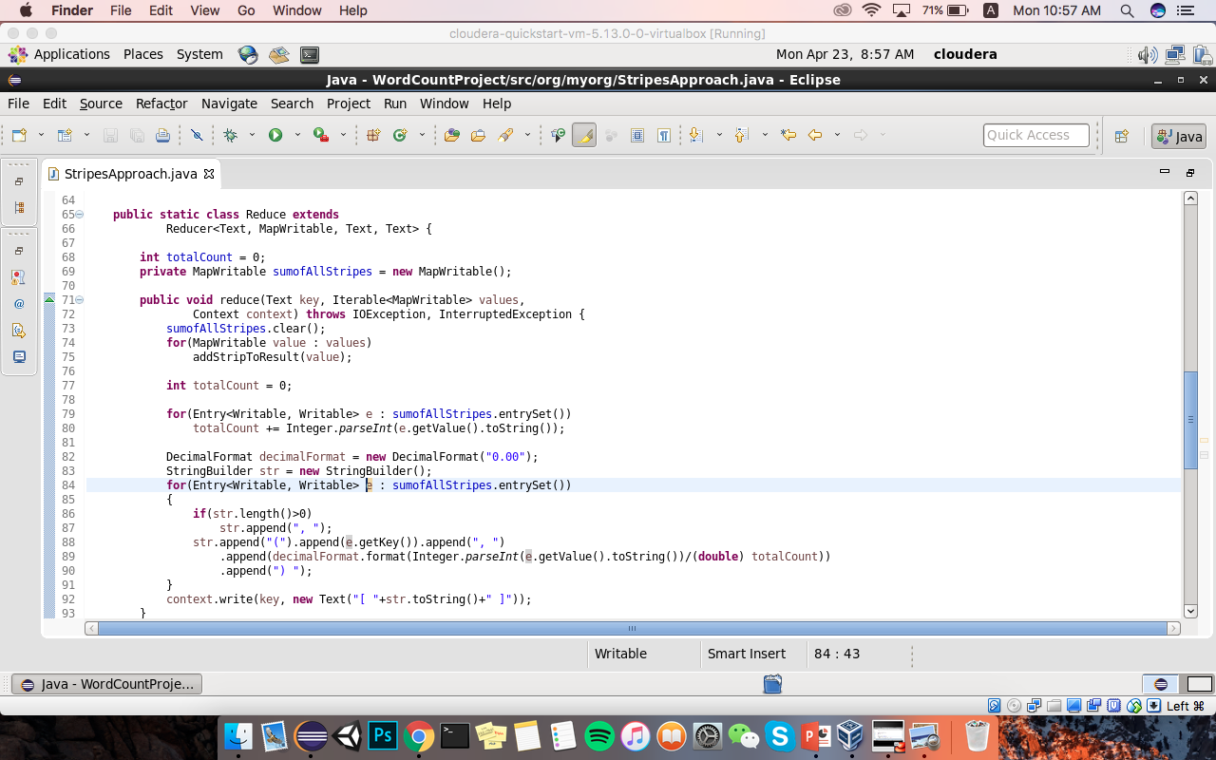
StripeApproach-Reduce

Slide 27
StripeApproach-Pseudo
Class Mapper
Method Map(docid a, doc d)
For all term w in doc d do
H = new AssociativeArray
For all term u in Neighbors(w) do
H{u} = H{u} + 1
Emit(Term w; Stripe H)
Class Reducer
Method Reduce(term w; stripes[H1; H2; ..])
Hf = new AssociativeArray
For all stripe H in stripes[H1; H2; ..]
Sum(Hf, H)
Total = total(Hf)
Hf= Hf/total
Emit(term w, stripe Hf)

Slide 28
Part4: Implement Hybrid algorithm to compute relative frequencies
Implemented Stripes and Pairs approach. Stored input data in /user/cloudera/wordcount/input2 , same as PairApproach and StripesApproach.
URL: org.myorg.HybridApproach
CMD1: hadoop jar /home/cloudera/wordcount.jar org.myorg.HybridApproach /user/cloudera/wordcount/input2 /user/cloudera/wordcount/output47 CMD2: hadoop fs –cat /user/cloudera/wordcount/output47/* CMD3: hadoop fs –cat /user/cloudera/wordcount/input2/*

Slide 29
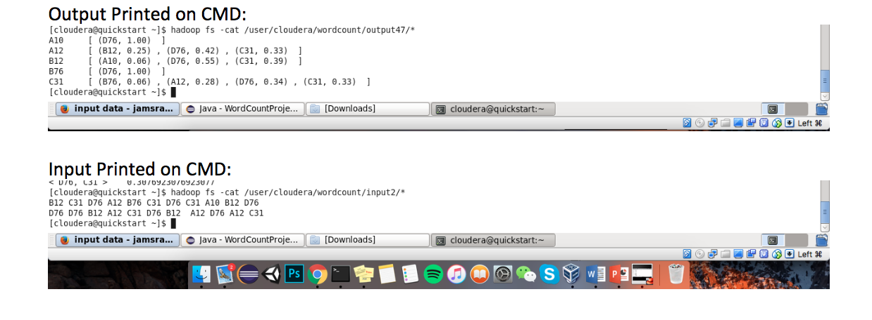
HybridAproach-Output&Input

Slide 30
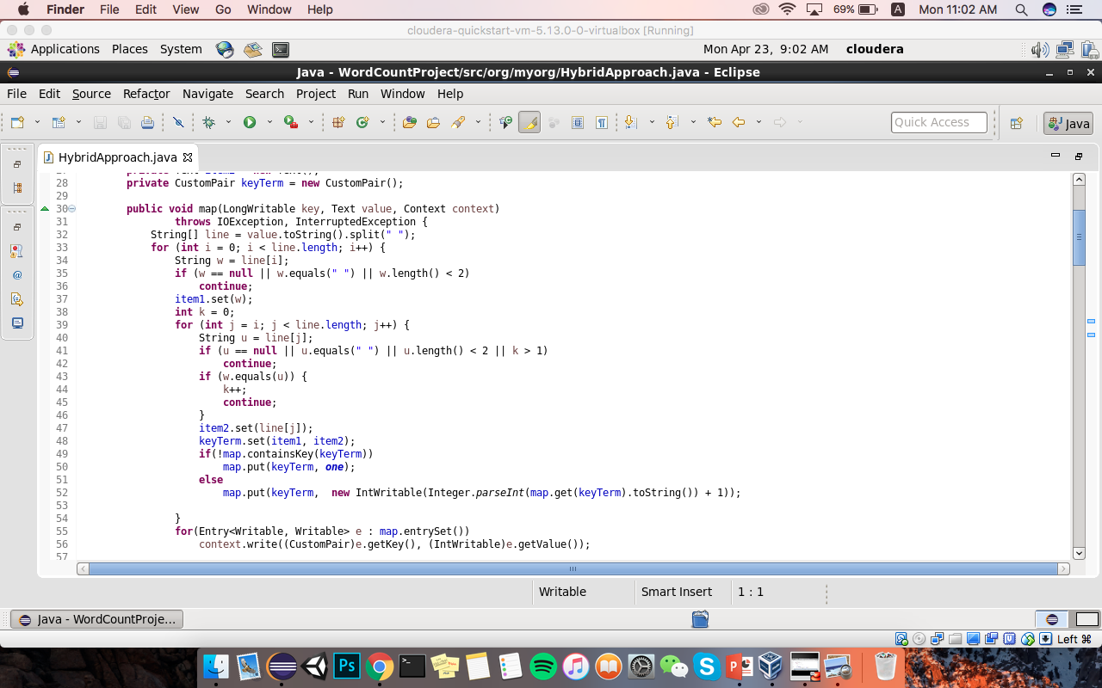
HybridAproach-Map

Slide 31
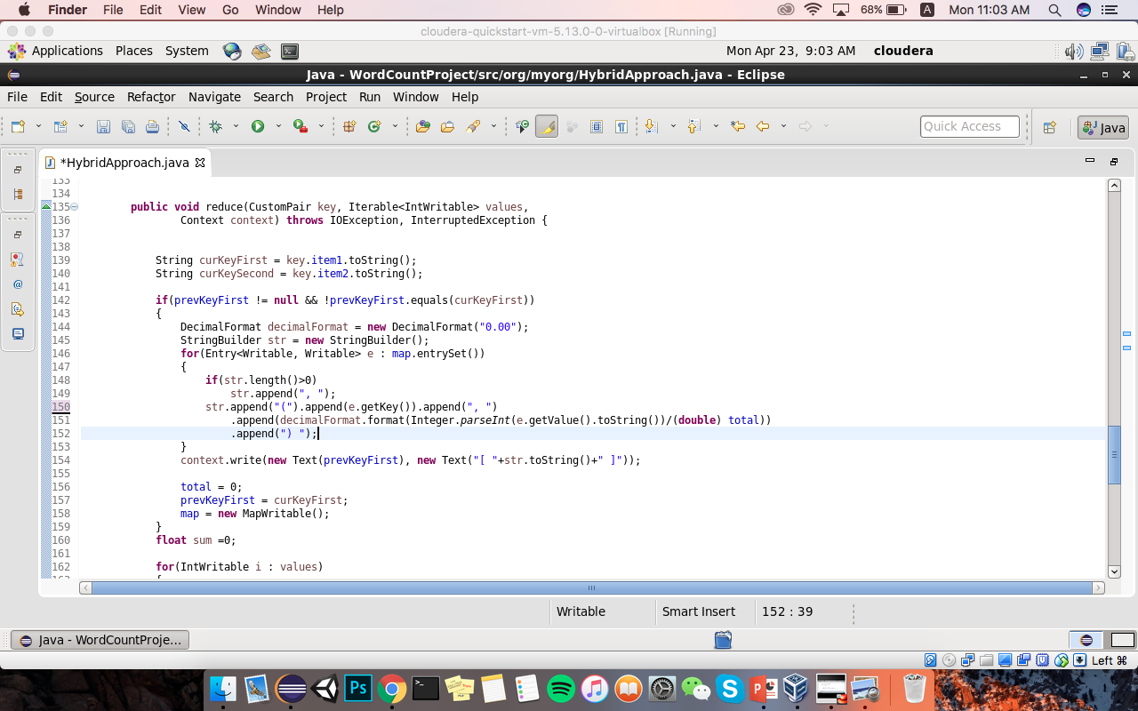
HybridAproach-Reduce

Slide 32
HybridAproach-Pseudo
Class Mapper
Method Initialize
H = new AssociativeArray
Method Map(docid a, doc d)
For all term w in doc d do
For all tern u in Neighbors(w) do
H{(w, u )} ++
Method Close
For all pair(w,u) in H do
Emit(pair(w, u), H{(w, u)})
Class Reducer
Method Initialize
wPrev = null
method Reduce(Pair p(w,u), counts[c1; c2; ..])
if(w != wPrev && wPrev != null)
total = total(H)
Emit(wPrev, H/total)
H.clear()
H{u} = sum(c1; c2;..)
wPrev = w
method close
total = total(H)
Emit(wPrev, H/total)

Slide 33
Part5 to Part 6
Used Cloudera Terminal on VirtualBox. Didn’t set up the environment on my own machine.
//importing necessary scala libraries
val sqlContext= new org.apache.spark.sql.SQLContext(sc)
import sqlContext._
import sqlContext.implicits._
import org.apache.spark.sql.DataFrame
import org.apache.spark.sql.functions._
import scala.collection.JavaConversions._
import scala.collection.mutable.ListBuffer

Slide 34
println("Step 1. Download a dataset (.csv file) from the site ")
//importing input file from local machine saving it on var named csv
val csv = sc.textFile("/user/cloudera/wordcount/nuclear.csv").cache()
case class Nuclear(nc_cost: Double, nc_date: String)
case class NuclearMean(nc_date: String, nc_mean: Double)
case class NuclearMeanVar(nc_date: String, nc_mean: Double, nc_variance: Double)
val headerAndRows = csv.map(line => line.split(",").map(_.trim)).cache()
val header = headerAndRows.first
val mtcdata = headerAndRows.filter(_(0) != header(0))

Slide 35
println("Step2. Select a categorical variable and a numeric variable and form the key-value pair and create a pairRDD called population.")
//creating PairRDD. I created Nuclear class and using it in this step
val nuclearRDD = mtcdata.map(p => Nuclear(p(1).toDouble, p(2))).toDF().cache()
nuclearRDD.printSchema

Slide 36
println("Step 3. Compute the mean mpg and variance for each category and display as shown below:")
println("Category Mean Variance")
//in order to calculate Mean and Variance I declared following function. It will take DataFrame and check condition as String and return to Double value which is Mean and Variance.
def computeMeanVariance(nucMeanRDD:DataFrame, ts:String ) : (Double, Double) = {
var sum1:Double = 0.00
var count:Int = 0
val mean = nucMeanRDD.filter(nucMeanRDD("nc_date").equalTo(ts)).select("nc_mean").collectAsList().get(0).getDouble(0)
val temp = nuclearRDD.filter(nuclearRDD("nc_date").equalTo(ts)).select("nc_cost").collectAsList()
for(fs <- temp){
val cost = fs.getDouble(0)
sum1 += math.sqrt((cost-mean)*(cost -mean))
count += 1
}
val nucMeanVarRDD = nucMeanRDD.filter(nucMeanRDD("nc_date").equalTo(ts)).map(p => NuclearMeanVar(p(0).toString, p(1).toString.toDouble, sum1/count)).toDF().cache()
return (mean.toString.toDouble, (sum1/count).toString.toDouble)
}

Slide 37
//calling the previously declared method here
val nucMeanRDD = (nuclearRDD.groupBy("nc_date").agg(avg("nc_cost"))).map(p => NuclearMean(p(0).toString, p(1).toString.toDouble)).toDF().cache()
for(ts <- nucMeanRDD.select("nc_date").distinct().rdd.map(r => r(0)).collect()){
val temp = computeMeanVariance(nucMeanRDD, ts.toString)
println(ts.toString+ " "+ temp._1 + " "+temp._2)
}

Slide 38
//Bootstrapping step… condition is false, 0.25
println("Step 4. Create the sample for bootstrapping. All you need to do is take 25% of the population without replacement.")
val mtNuclearBoostrapperRDD = nuclearRDD.sample(false, 0.25)

Slide 39
println("Step 5. Do 1000 times")
println("Category Mean Variance")
val listVariance = new ListBuffer[NuclearMeanVar]()
//looping 1000 times
for { x <-1 to 1000 }
{
val mtResampledDate = mtNuclearBoostrapperRDD.sample(true, 1);
for(ts <- mtResampledDate.select("nc_date").distinct().rdd.map(r => r(0)).collect()){
val temp = computeMeanVarianceFinal(mtResampledDate, ts.toString)
//calculating the mean and variance on each loop
val mv = NuclearMeanVar(ts.toString, temp._1, temp._2)
//saving Mean and Variance into list. This will help to calculate next step
listVariance += mv
println(ts.toString+ " "+ temp._1 + " "+temp._2)
}
}

Slide 40
println("Step 6. Divide each quantity by 1000 to get the average and display the result.")
//declared another function that find the average of given Dataframe
def computeFinal(lastRDD:DataFrame, ts:String ) = {
val meanAVG = lastRDD.filter(lastRDD("nc_date").equalTo(ts)).agg(avg("nc_mean")).collectAsList().get(0).getDouble(0)
val varianceAVG = lastRDD.filter(lastRDD("nc_date").equalTo(ts)).agg(avg("nc_variance")).collectAsList().get(0).getDouble(0)
println (ts.toString +" " + meanAVG.toString.toDouble +" " + varianceAVG.toString.toDouble)
}
println("Category Mean Variance")
//Calling the previously created function
for(ts <- mtNuclearBoostrapperRDD.select("nc_date").distinct().rdd.map(r => r(0)).collect()){
computeFinal(listVariance.toDF(), ts.toString)
}

